Slide 1
Module 1.6
Advanced Control Hijacking Attacks

Slide 2

Advanced Hijacking Attacks
Control Hijacking

Slide 3
Heap Spray Attacks
A reliable method for exploiting heap overflows

Slide 4
Heap-based control hijacking
Compiler generated function pointers (e.g. C++ code)
Suppose vtable is on the heap next to a string object:
method #1
FP1
ptr
FP2
method #2
FP3
method #3
data
vtable
Object T
buf[256]
vtable
ptr
data
object T

Slide 5
Heap-based control hijacking
Compiler generated function pointers (e.g. C++ code)
After overflow of buf we have:
method #1
FP1
ptr
FP2
method #2
FP3
method #3
data
vtable
Object T
shell code
buf[256]
vtable
ptr
data
object T

Slide 6
A reliable exploit?
<SCRIPT language="text/javascript">
shellcode = unescape("%u4343%u4343%...");
overflow-string = unescape(“%u2332%u4276%...”);
cause-overflow( overflow-string ); // overflow buf[ ]
</SCRIPT>
Problem: attacker does not know where browser places shellcode on the heap
???
buf[256]
vtable
ptr
data
shellcode

Slide 7
Heap Spraying [SkyLined 2004]
Idea: 1. use Javascript to spray heap with shellcode (and NOP slides)
2. then point vtable ptr anywhere in spray area
NOP slide
shellcode
heap
vtable
heap spray area

Slide 8
Javascript heap spraying
var nop = unescape(“%u9090%u9090”)
while (nop.length < 0x100000) nop += nop
var shellcode = unescape("%u4343%u4343%...");
var x = new Array ()
for (i=0; i<1000; i++) {
x[i] = nop + shellcode;
}
Pointing func-ptr almost anywhere in heap will cause shellcode to execute.

Slide 9


Vulnerable buffer placement
Placing vulnerable buf[256] next to object O:
By sequence of Javascript allocations and frees make heap look as follows:
Allocate vuln. buffer in Javascript and cause overflow
Successfully used against a Safari PCRE overflow [DHM’08]
free blocks
heap
object O

Slide 10
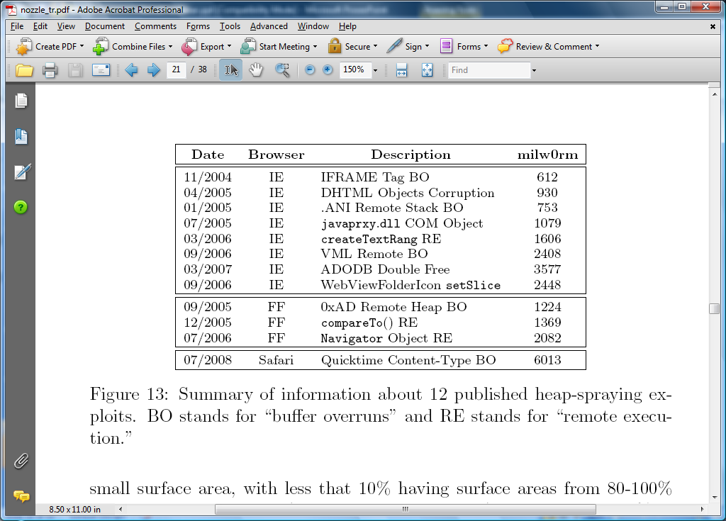
Many heap spray exploits
[RLZ’08]
Improvements: Heap Feng Shui [S’07]
Reliable heap exploits on IE without spraying
Gives attacker full control of IE heap from Javascript

Slide 11

(partial) Defenses
Protect heap function pointers (e.g. PointGuard)
Better browser architecture:
Store JavaScript strings in a separate heap from browser heap
OpenBSD heap overflow protection:
Nozzle [RLZ’08] : detect sprays by prevalence of code on heap
prevents cross-page overflows
non-writable pages

Slide 12
References on heap spraying
[1] Heap Feng Shui in Javascript, by A. Sotirov, Blackhat Europe 2007
[2] Engineering Heap Overflow Exploits with JavaScript M. Daniel, J. Honoroff, and C. Miller, WooT 2008
[3] Nozzle: A Defense Against Heap-spraying Code Injection Attacks,
by P. Ratanaworabhan, B. Livshits, and B. Zorn
[4] Interpreter Exploitation: Pointer inference and JiT spraying, by Dion Blazakis

Slide 13
Lecture 1: Summary
Total 6 Modules on Control Hijacking
Module 1.1: Basic Control Hijacking Attacks : Buffer Overflow
Module 1.2: Integer Overflow
Module 1.3: Formal String Vulnerability
Module 1.4: Defenses Against Control Hijacking – Platform Based Defenses
Module 1.5: Run-Time Defenses
Module 1.6: Some Advanced Control Hijacking Attacks

